Slide 1
BUSINESS ANALYTICS PRESENTER: DRISHA.J

Slide 2
BUISNESS ANALYTICS
What is Buisness Analytics?
Business Analytics is the practice of using data, statistical methods, and predictive models to analyze business performance, gain insights, and support data-driven decision making.
It combines business knowledge, data science, and technology to improve efficiency, identify opportunities, and predict future outcomes.
Core Components:
Descriptive Analytics – Explains what happened (past trends, reports).
Diagnostic Analytics – Explains why it happened (root cause analysis).
Predictive Analytics – Forecasts what could happen (machine learning, forecasting).
Prescriptive Analytics – Suggests what actions to take (optimization, decision support).

Slide 3
OVERVIEW OF TOPICS
Primary topics
Agile & Scrum Fundamentals – Roles, ceremonies, artifacts
User Stories – Writing clear acceptance criteria
UML Diagrams – Use case, activity, and sequence diagrams
Secondary topics
REST APIs Basics – Understanding request-response flows
Cloud Overview – High-level AWS and Azure capabilities
Machine Learning Basics – High-level understanding of AI use cases
Testing Tools – Using Postman for API validation

Slide 4
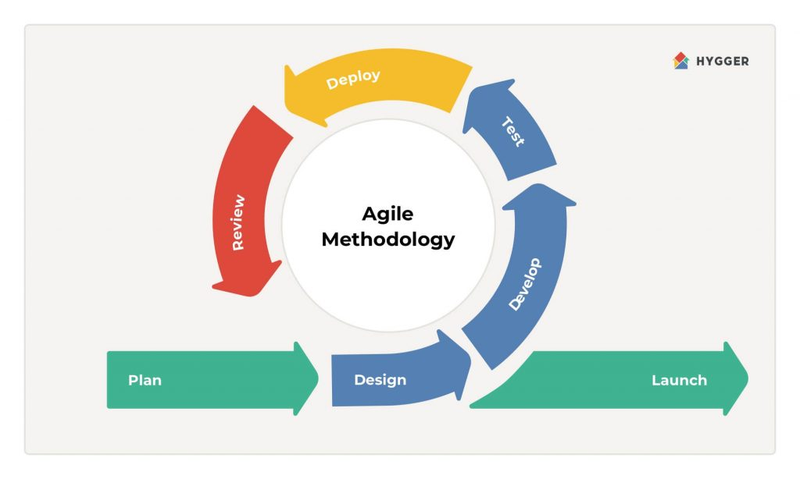
AGILE METHEDOLOGY
Definition:
Agile is an iterative and incremental approach to software development.
Focuses on flexibility, collaboration, customer feedback, and rapid delivery
Why Agile?
Responds quickly to changing business needs.
Encourages customer involvement throughout the process.
Delivers small, working increments frequently.
Agile Values:
Individuals & interactions – Processes & tools
Working software – Comprehensive documentation
Customer collaboration – Contract negotiation
Responding to change – Following a plan

Slide 5
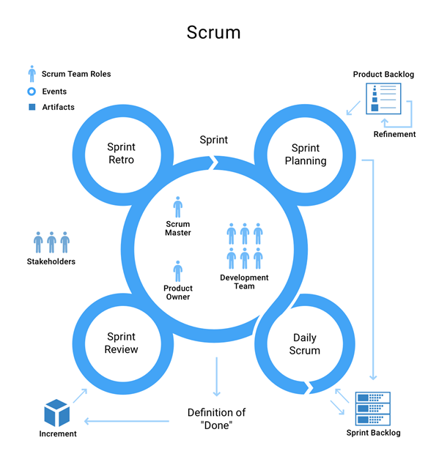
SCRUM FUNDAMENTALS
Introduction to Scrum:
Scrum is an Agile framework for developing, delivering, and sustaining complex products.
Focuses on collaboration, adaptability, and delivering value quickly.
Scrum Roles:
Product Owner (PO):
Defines product vision.
Manages the Product Backlog (list of features, requirements, tasks).
Prioritizes work based on business value.
Scrum Master (SM):
Servant leader and coach.
Ensures the team follows Scrum principles.
Removes impediments and protects the team from external interruptions.
Development Team:
Cross-functional professionals.
Self-organizing and responsible for delivering increments.
Typically 5–9 members.

Slide 6
Scrum Ceremonies (Events):
1. Sprint
Fixed time-box (1–4 weeks).
Goal: Deliver a working product increment.
2. Sprint Planning
Decide what to build in the sprint.
Define Sprint Goal & plan tasks.
3. Daily Scrum (Stand-up)
15-min daily sync.
Share: Yesterday’s work, today’s plan, blockers.
4. Sprint Review
End-of-sprint demo to stakeholders.
Gather feedback & update backlog.
5. Sprint Retrospective
Reflect on sprint process.
Identify improvements for next sprint
. Scrum Artifacts:
1.Product Backlog
Ordered list of everything needed in the product.
Managed by the Product Owner.
2.Sprint Backlog
Subset of product backlog items selected for a sprint.
Includes a plan for delivering the increment.
3.Increment
A working product slice delivered at the end of each sprint.
Must be “Done” (meets Definition of Done).

Slide 7
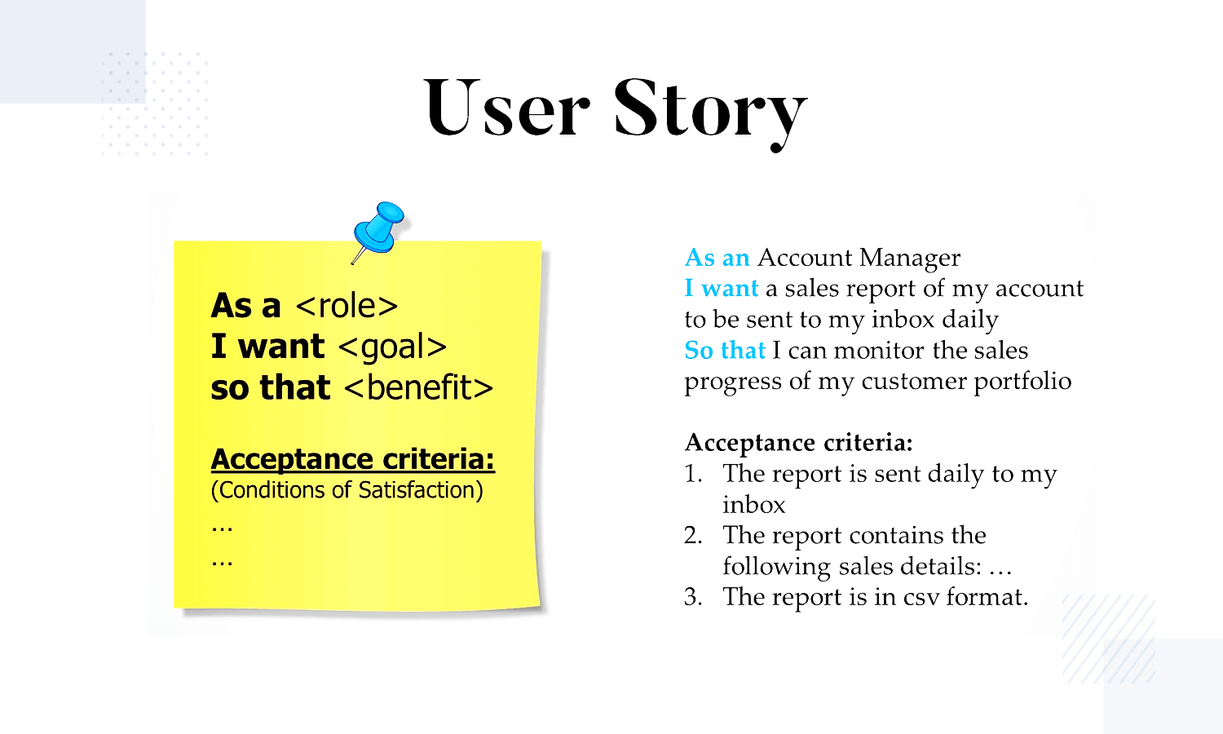
USER STORIES
What are User Stories?
A user story is a short, simple description of a feature from the perspective of the end-user.
Format: As a [role], I want [feature] so that [benefit].
Example: As a customer, I want to filter products by price so that I can find affordable options quickly.
Importance of User Stories:
Focus on end-user needs.
Encourage collaboration between business analysts, developers, and sh.
Provides clarity for requirements and reduces ambiguity.
Forms the basis for estimating, planning, and testing in Agile/Scrum

Slide 8
ACCEPTANCE CRITERIA
What is Acceptance Criteria?
Definition: Acceptance Criteria are specific, predefined conditions that a software product or feature must meet to be accepted by stakeholders or end-users.
They act as a contract between the development team and the stakeholders.
Why Acceptance Criteria is Important?
1.Clarity & Alignment:
Prevents ambiguity between stakeholders, developers, and testers.
2.Testability
Serves as the basis for test cases and QA validation.
3.User-Centric Development
Ensures the product meets real user needs.
Types of Acceptance Criteria:
Functional Criteria – Defines specific system behaviors.
Non-Functional Criteria – Defines performance, security, or usability aspects.
Boundary Conditions – Specifies limits and restrictions.
How to Write Clear Acceptance Criteria?
Be Specific: Avoid vague terms like “fast” or “easy”.
Use Simple Language: Make it clear for both business & tech teams.
Follow a Format :
Scenario/Rule-based - If X happens, then Y should occur.
Given-When-Then (Gherkin) -
Given a starting context
When an action is taken
Then an expected outcome should occur
Make it Testable - Each criterion should have a clear Pass/Fail.
Cover Edge Cases - Think of unusual situations or errors.
Example (E-commerce App – Login):
Given a registered user, when they enter valid credentials, then they should be logged in.
Given wrong credentials, when they try to log in, then an error message should be shown.

Slide 9
UML DIAGRAMS
What is UML and why use it? Unified Modeling Language (UML) – visual language for modeling software systems.
Helps stakeholders (business, developers, testers, architects) see requirements and behavior.
Use different diagram types for different needs: scope (use case), process (activity), interaction timing (sequence).
Why UML is important in Business Analytics?
Converts business requirements into visual models.
Makes complex workflows easy to understand.
Ensures clear communication between business & technical teams.
Reduces misunderstandings in requirements.

Slide 10
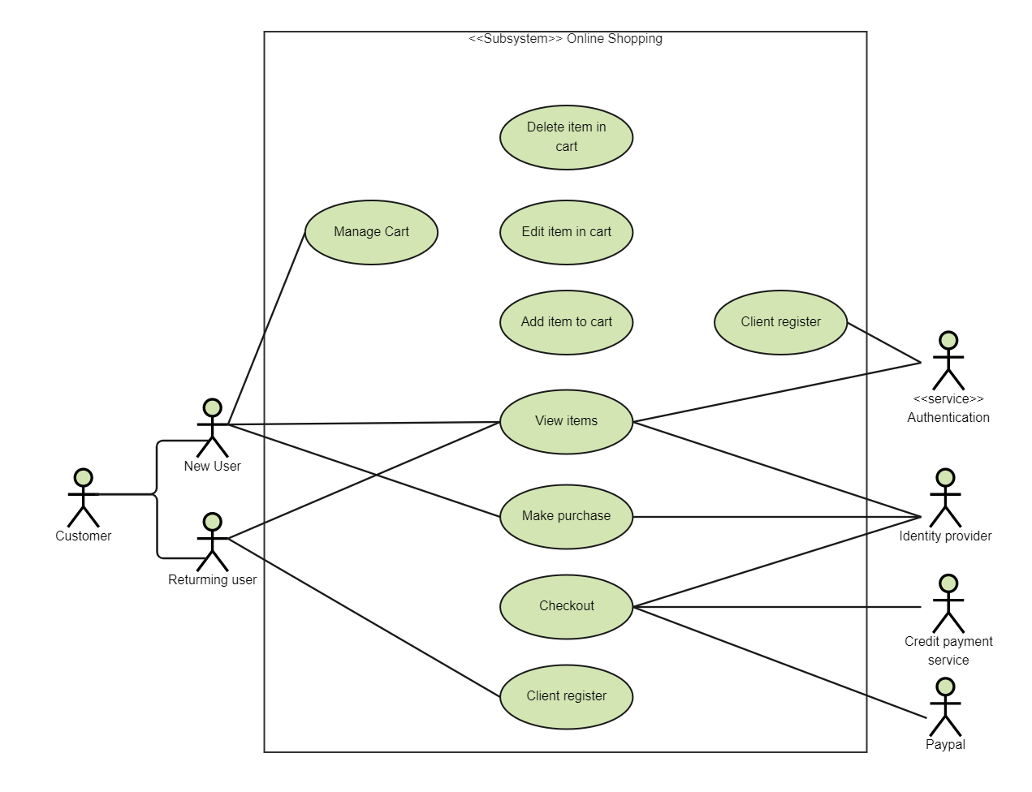
USE CASE DIAGRAM
What is Use Case Diagram?
A high-level view of what the system should do from the end-user’s perspective.
Focuses on actors (users or external systems) and the use cases (functions/services) they interact with.
Why it is Important for a Buisness Analyst?
Defines functional requirements clearly.
Helps in requirement elicitation by showing who interacts with what.
Aligns business stakeholders and technical teams on system scope.
Example (E-commerce system):
Actors: Customer, Admin, Payment Gateway.
Use cases: Browse Products, Add to Cart, Checkout, Make Payment, Track Order.

Slide 11
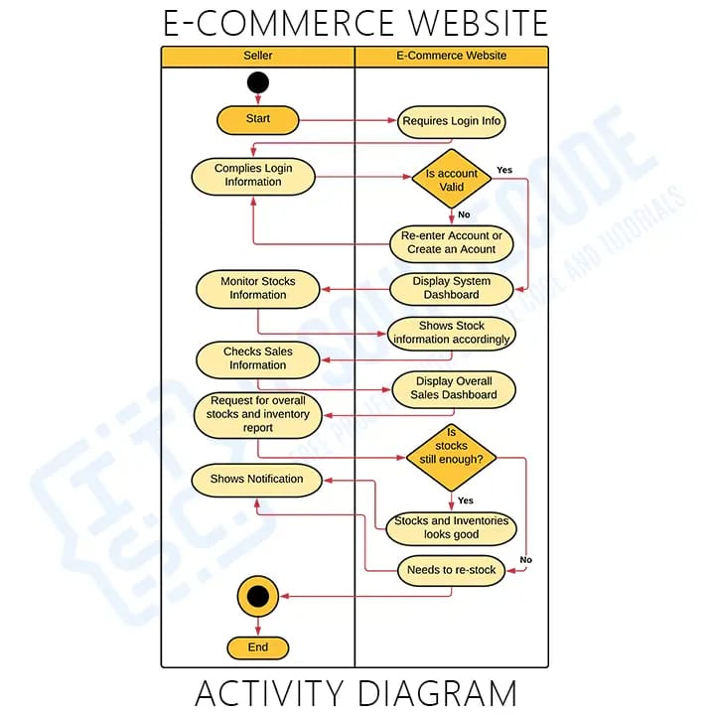
ACTIVITY DIAGRAM
What is Activity Diagram?
A workflow diagram showing step-by-step activities, decisions, and outcomes.
Visualizes business processes and their variations.
Why it is Important for a Buisness Analyst?
Clarifies business rules and flows.
Identifies bottlenecks, alternate paths, and dependencies.
Used to validate processes with non-technical stakeholders.
Example (Checkout process):
Customer browses –> Adds item –> Checkout –> Enters shipping details.
Decision: If payment succeeds –> Create order –> Send confirmation. If fails –> Show error –> Retry/Cancel.

Slide 12
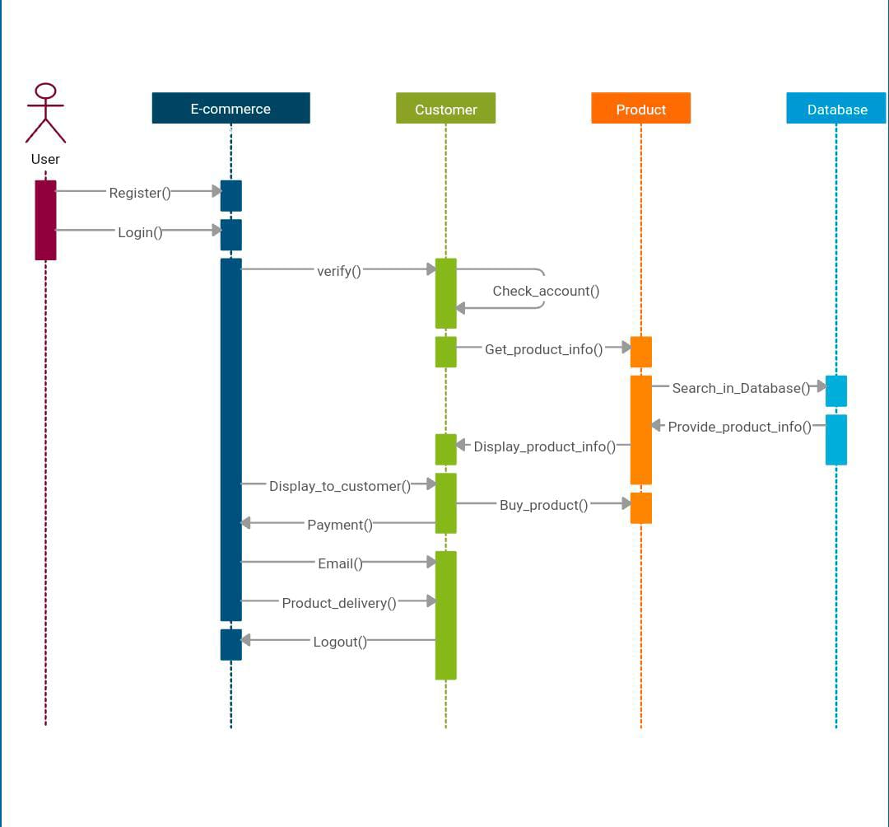
SEQUENCE DIAGRAM
What Is Sequence Diagram?
A time-ordered diagram that shows how different actors/systems interact with one another step by step.
Focuses on the order of communication between users, systems, and services.
Why it is Important for a Business Analyst?
Helps in understanding integration points.
Useful for API design discussions or when multiple systems are involved.
Shows what happens first, next, and last during a transaction.
Example (Place Order):
Customer –>Web Portal –> Order Service –> Payment Gateway –>Inventory –> Shipping.

Slide 13
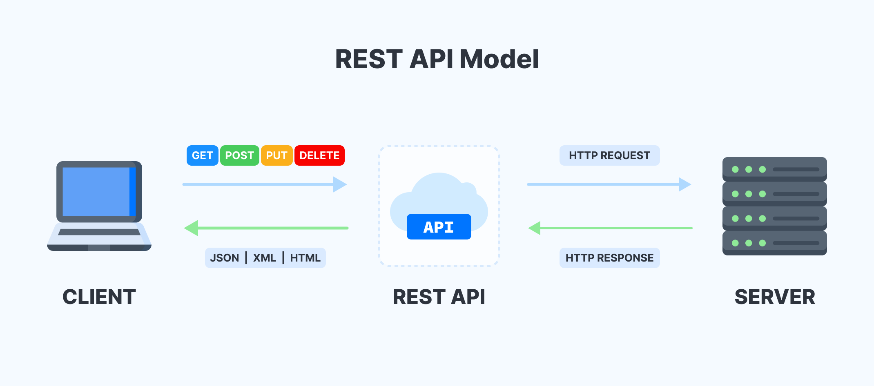
REST APIs BASICS
what is REST APIs?
REST (Representational State Transfer) APIs allow communication between systems over HTTP.
It’s a standard way to send and receive data between a client (e.g., browser, mobile app) and server.
Key Concepts:
Request: Client sends data or asks for information (GET, POST, PUT, DELETE).
Response: Server sends back the requested data along with a status code(200 OK, 404 Not Found).
Example:
A Business Analytics dashboard needs sales data from an ERP system.
1.Request: GET /sales-data?month=September
2.Response: JSON containing sales figures for September.
Sql:GET https://api.company.com/sales?month=September
Json body:
{
"month": "September",
"total_sales": 150000,
"region": "North"
}

Slide 14
Request–Response Flows
How the Flow Works
Step-by-Step Example:
What is a Request–Response Flow?
It’s the communication process between a client and a server in a web or API system.
When you access a web page, use a dashboard, or connect to a data API — a request is sent, and a response is received.
This mechanism ensures data exchange between applications (for example, between a business analytics dashboard and a company’s database).
Why It Matters for a Business Analyst?
Communicate better with developers and data teams.
Identify data sources for reports and dashboards.
Ensure data integrity, accuracy, and timeliness in analytics solutions.
Example: When your BI tool (like Power BI or Tableau) fetches customer sale data from a company’s API, it uses a request–response flow.
Step | Action | Description
1 | Client Sends Request | The analytics dashboard sends a request to the server, e.g., GET /sales?month=September
2 | Server Processes Request | The server checks the database for September sales data.
3 | Server Sends Response | The server replies with the requested data in JSON format.
4 | Client Displays Data | The dashboard visualizes the data as charts or tables.

Slide 15
CLOUD OVERVIEW
Definition of Cloud?
Cloud Computing is the delivery of data storage, analytics, and software services over the internet (“the cloud”) instead of using local servers or personal computers.
Example: Instead of storing all your sales data on a local computer, you upload it to AWS S3 or Azure Blob Storage, so your analytics dashboard (like Power BI or Tableau) can fetch it anytime, anywhere.
Importance of Cloud for Business Analytics:
For Business Analysts, the cloud provides:
Centralized Data Access – All business data is stored in one secure location.
Collaboration – Teams across locations can access real-time analytics.
Cost Efficiency – Pay only for the resources used, no server maintenance.
Faster Insights – Cloud analytics tools reduce time from data collection to visualization.
How Business Analysts Use Cloud Platforms?
Use Case 1: Sales Analysis
Store daily sales in S3.
Transform and analyze data in Synapse.
Visualize insights in Power BI.
Use Case 2: Customer Behavior Tracking
Collect user activity streams
Analyze real-time engagement trends.
Use Case 3: Forecasting & Reporting
Automate ETL pipelines.
Refresh dashboards automatically.
Share insights securely across departments.

Slide 16
HIGH-LEVEL AWS & AZURE CAPABILITIES
Capability | AWS Definition | Azure Definition | BA Relevance
Data Storage | Amazon S3: Cloud storage for raw and processed data files (CSV, JSON, Parquet), centralized, durable, and scalable. | Azure Data Lake / Blob Storage: Centralized storage for structured and unstructured data. | Serves as a single source of truth; supports historical analysis and auditing.
Data Warehouse | Amazon Redshift: Cloud data warehouse optimized for fast SQL analytics on large datasets. | Azure Synapse Analytics: Unified analytics service combining data warehousing & big data processing. | Powers dashboards and reports with aggregated, ready-to-use data.
Data Integration | AWS Glue: Fully managed ETL service; extracts, transforms, loads data; auto-discovers schema and maintains a catalog. | Azure Data Factory: Cloud ETL and workflow orchestration tool for data movement and transformation. | Ensures data is clean, standardized, and ready for analysis.
Real-time Data | Amazon Kinesis: Platform to ingest and process real-time data streams (clicks, transactions, sensor events). | Azure Event Hubs + Stream Analytics: Real-time ingestion and processing of event streams. | Enables live dashboards and operational monitoring in near real-time.
Machine Learning | Amazon SageMaker: Cloud platform to build, train, deploy, and manage ML models with prediction endpoints. | Azure Machine Learning: Platform to build, train, deploy, and manage ML models. | Supports forecasting, scoring, and predictive analytics in reports/dashboards.
Visualization | Amazon QuickSight: Cloud-based BI tool to create interactive dashboards, reports, and Q&A. | Power BI: Interactive cloud BI platform for dashboards, reporting, and analytics. | Enables visualization, exploration, and quick insights from curated data.
 |  |  | .

Slide 17
MACHINE LEARNING BASICS
What is Machine Learning (ML)?
Machine Learning is a subset of Artificial Intelligence (AI) that allows systems to learn patterns from data and make decisions or predictions without being explicitly programmed.
Why Should a Business Analyst Understand ML?
You act as a bridge between business stakeholders and data science teams.
You need to translate business problems into data problems and vice versa.
You help identify AI/ML use cases that align with strategic goals.
You may contribute to defining model requirements, KPIs, and success criteria.
Key ML Concepts:
Data: Used to train and test ML models (input and output data).
Features: Attributes or characteristics (e.g., age, spending habits).
Labels: The output or target variable (e.g., churned customer = Yes/No).
Algorithm: The mathematical method for building a model (e.g., Linear Regression, Decision Trees).
Training and Testing: Models are trained on data and then tested for accuracy.
Types of Machine Learning:
1.Supervised Learning: Uses labeled data to train the model (e.g., predicting customer churn).
2.Unsupervised Learning: Finds hidden patterns in unlabeled data (e.g., customer segmentation).
3.Reinforcement Learning: Learns from trial and error based on feedback (e.g., dynamic pricing).
Steps in the ML Process:
1.Data Collection: Gather relevant data.
2.Data Preprocessing: Clean and format the data.
3.Model Training: Use an algorithm to learn from data.
4.Model Evaluation: Test the model’s accuracy.
5.Model Deployment: Implement the model in production.
BA's Role in ML Projects:
Understand business needs and define success metrics.
Collaborate with data scientists to ensure models align with business goals.
Validate and interpret ML outputs to make data-driven decisions.

Slide 18
High-Level Understanding of AI Use Cases
1. Customer Segmentation
Purpose: Group customers based on behavior or demographics to target them effectively.
Example: Retail stores segment customers into "budget shoppers" or "high-value customers" and send tailored promotions.
BA Role: Define segment criteria, validate clusters, and track marketing effectiveness.
2.Churn Prediction
Purpose: Identify customers likely to leave and intervene before they do.
Example: A telecom company predicts which customers might cancel their service and offers retention plans.
BA Role: Define churn, collaborate with data teams, and implement retention strategies.
3.Sales Forecasting
Purpose: Predict future sales based on past data to optimize inventory and budgeting.
Example: A retailer forecasts sales for winter wear and adjusts inventory accordingly.
BA Role: Define business drivers, validate forecast accuracy, and communicate results to stakeholders.
4.Recommendation Systems
Purpose: Suggest products/services based on user behavior to increase engagement and sales.
Example: Amazon suggests products based on past purchases or browsing history.
BA Role: Guide recommendation logic, monitor performance, and ensure alignment with business goals.
5.Fraud Detection
Purpose: Detect unusual or fraudulent activity in transactions to minimize risk.
Example: Banks flag suspicious transactions like large purchases in unusual locations.
BA Role: Define fraud patterns, ensure business logic is followed, and track model performance.
6.Price Optimization
Purpose: Dynamically adjust prices based on demand, competition, and user behavior.
Example: Airlines increase prices during high demand and adjust based on competitor pricing.
BA Role: Set pricing goals, monitor AI decisions, and evaluate sales impact.

Slide 19
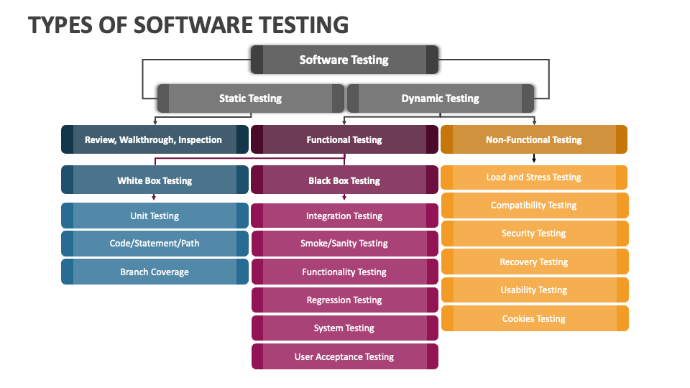
TESTING TOOLS
What is Testing?
Testing is the process of checking if a software system works correctly, meets business requirements, and performs well. As you ensure that the system aligns with business goals, provides a great user experience, and works as expected in real-world conditions.
Types of Testing :
1.Functional Testing: Ensures the software functions as required by business needs
Example- checkout process works on an e-commerce site
2.Non-Functional Testing: Verifies non-functional aspects like performance, security, and usability
Example- system can handle heavy user traffic
3.Regression Testing: Ensures new changes don’t break existing functionality
Example- confirming the order system still works after an update
4.User Acceptance Testing (UAT): Involves business users to validate if the system meets their needs
Example- users test a new payroll system
5.Integration Testing: Confirms different parts of the system or external systems work together smoothly.
Example:payment gateway integration
6.Acceptance Testing: Verifies the software is ready for deployment and meets business criteria.
Example- If all the works runs as expected

Slide 20
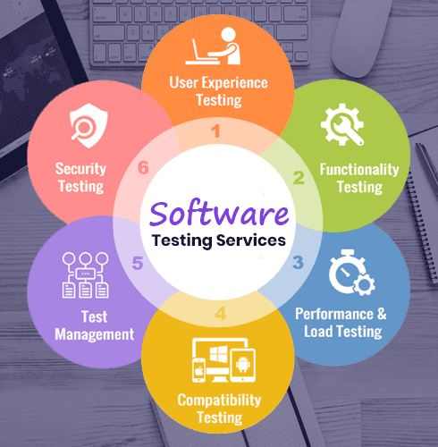
Popular Testing Tools :
1.Postman: Used for API testing. Helps ensure that APIs return correct data and function as required.
Example: Verify payment gateway API works correctly.
2.Selenium: Used for automated UI testing of web applications.
Example: Test the registration process on an e-commerce site.
3.JIRA: A project management tool used for tracking bugs and issues.
Example: Track bugs in the order management system
4.Jenkins: Automates the process of testing and integration during development.
Example: Automatically run tests after each software update.
5.TestRail: A tool for managing and organizing test cases and tracking testing progress.
Example: Manage test cases for a new feature, like an inventory management system.
6.LoadRunner: Used for performance testing,
Example: Test the website’s performance during peak shopping hours.
BA’s Role in Testing:
Define Requirements: Ensure the test cases align with business needs.
Track Progress: Use tools like JIRA to track bugs and test progress.
Validate: Participate in User Acceptance Testing (UAT) to ensure the software meets business goals and user needs.
Collaborate: Work with QA and developers to ensure the system works as expected.

Slide 21
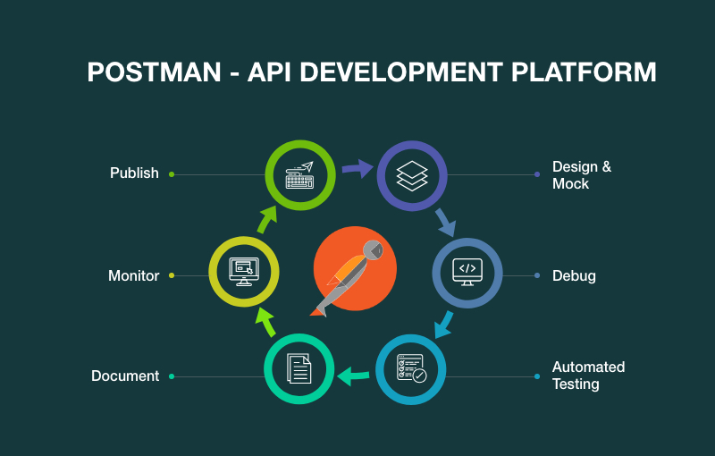
POSTMAN FOR API VALIDATION
Key Steps to Use Postman for API Validation:
1.Identify the API to Test:
choose critical APIs like payment gateways or user authentication that support business functions.
2.Send API Requests:
Use GET, POST, PUT, or DELETE methods to interact with the API.
Set URL, headers, and body (for POST/PUT) to match business needs (e.g., sending user data).
3.Validate Response:
Status Code: Check if it’s 200 OK, 201 Created, etc.
Response Body: Ensure the correct data is returned (e.g., user info, payment success).
Response Time: Ensure the system responds in a timely manner.
4.Write Tests (Assertions):
Write simple tests to check if the API returns the correct status and data.
Example:
pm.test("Status code is 200", function() {
pm.response.to.have.status(200);
});
5.Automate with Collections:
Group requests into collections for organized testing.
Use Newman to run tests automatically as part of a CI/CD pipeline.

Slide 22
THANK YOU PRESENTED BY:DRISHA.J

